Slide 1
Regularization
Chapter 7
Notes:
Being robust to environmental changes makes robust against overfitting
https://www.youtube.com/watch?v=DleXA5ADG78&app=desktop
Gaussian noise to input is like l2 penalty – why?

Slide 2
Why and what-for?
To optimize problem of a) fitting the current data well (no underfitting) and b) generalizing well to new datasets (no overfitting)
Reduces generalization error, not training error
There is no best way for regularizing, has to be well-suited to classification task
Nomenclature (from chapter 5):
Notes:
Point estimation: estimate parameters that gave rise to data in training set
Function estimation: estimate relationship between input and target variables
Example estimating mean or variance of training samples
So for example if the estimate is the mean of the distribution, averaging across inputs is an unbiased estimator (not always right, but has the ability to capture the mean unbiased if repeated lots of times). In variance not the case, because squared measure where deviations don’t average out
Bias of an estimator: deviation of true underlying parameter theta from estimator of this parameter (e.g. mean) (e.g. mean of gaussian distribution can be estimated without bias from mean of generated means, variance estimate is biased and has to be corrected)
Variance: Whenever, we cannot sample indifinetly, there will be variance between estimators of repeated sampling, (it decreases as a function of m)
MSE: (mean square error of difference between estimator and true parameter), contains bias as well as variance
If asssumed that train set and test set are from same distributions, training and test error should be expected to be the same. However, we can underfit (have high test error) or overfit(have large difference between test and train error) – I think variance in estimator approximates generalization error because training and test distribution are assumed to have the same properties
Capacity: can be altered to rather fit training set better or rather fit test set better, Simply put, increased capacity might be increased number of parameters In learning algorithm (function translating input to targets?)
Behavior of learning algorith is strongly affected by how many fucntions we allow into the hypothesis space, but also by how complex variations on these fucntions can get. To prevent overfitting, we can introduce an additional criterion for fitting. Chpter 5 page 119f, e.g. fucntions with smaller weights, added as additional term in determining (so it is intended to reduce generalization error, not trainign error.

Slide 3
How does it work?
General goal of regularization is being more robust to environmental changes (If there is not much variability between training (test) sets, overfitting is less of a problem)
Different strategies to regularize:
Adding terms in cost function (L² and L¹) that affect parameter values (weights), thereby limiting the capacity of models
Augment datasets (create fake data, add noise)
Configure learning as an ensemble process to improve adaptation to different environments (multi-task learning)
Cheating (early stopping)
Putting constraints on the learning model (reflecting prior knowledge of data structure or reflecting a preference for a type of model)

Slide 4
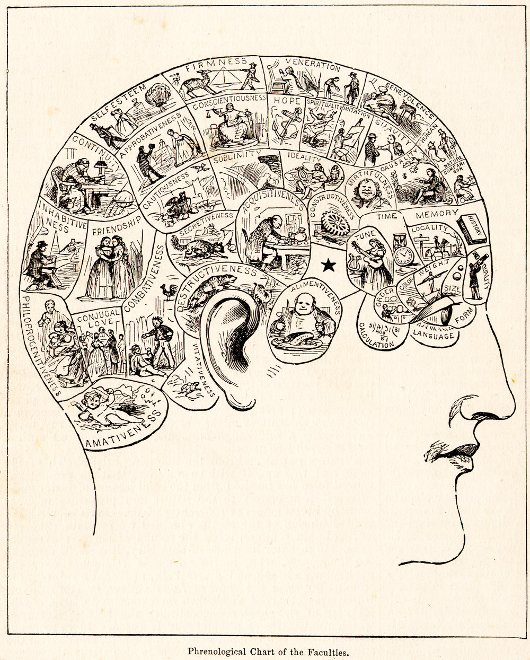
Note however
Even though regularization improves the learning model such that we fit true data better, this does not mean that we approximate the true data generating process.
Notes:
What does this tell us about how much we learn about the brain then?
Evtl. Phrenology
accordingly

Slide 5
a) Adding terms in cost function
Training then aims to minimize cost function as well as minimize error of chosen parameter norm (targeting usually the weights –> weight decay), α determines how important regularization is relative to fitting the training set.
L² parameter regularization
-> will favor smaller weights.
When used? Smaller datasets, e.g.
Intuitive explanation why weight decay might be useful for generalization:
Example training data:
1 1 0 0 -> 6 (target)
1 1 1 1 -> 4
-5 +11 +4 -6 co-adapted weights L²: sqrt(25+121+16+36) = ½*26²
+3 +3 -1 -1 less co-adapted weights (more generalizable) L²: sqrt(9+9+1+1) = ½*8²
Notes:
Weights are reduced because this means that parameters are kept close to a point in space which makes sense if we do not know whether the weights will be negative or positive
How is this done? Well, this complicated thing with the optimal weights w* and hessian matrix of J with respect to w evaluated wrt w*. So basically, this sorts out how the weights should be optimally adapted (not all weights adapted to the same extent)
Especially good approximation if quadratic cost function used)
Is the green one a good example? So this basically shows that it might be more adaptive to not emphasize one weight (one connection between model units too much)
J is objective function, theta are parameters, x inputs, y targets alpha is weight (how much regularization do I want?)
Usually weights are taken rather than bias (value of individual units). If applied to input data, this works as perceived increased variance of input units. Then shrinks weights on features that have low covariance with output target as compared to this added variance. So only important covariance between feautures with ouput variance will survive.

Slide 6
a) Adding terms in cost function
L¹ parameter regularization (minimize sum of weights)
-> will produce sparser weights (and more of those the larger α).
Has been used extensively when feature selection is useful (LASSO, least absolute shrinkage and selection operator: L¹ penalty, linear model, least squares cost function)
When used? Datasets with outliers, datasets requiring feature selection.
Nice comparison L1 and L2: http://www.chioka.in/differences-between-l1-and-l2-as-loss-function-and-regularization/
Notes:
L2 cost function more dependent on outliers
Nice explanation why loss of weights in L1: in L2, less gain for squre if small change in weights
There is an analytical solution to that were there are two cases, one where the optimal weights w* for minimizing cost function are smaller than the suggested amount of shifting them – will be set to 0 and one where they are larger, than they will just be shifted towards zero by suggested amount.
Nice comparison: L2 more sesitive to outlers because squared values of weights, L1 can produce several equivcalent solutions (sum less differentiating then euclidian distance)

Slide 7
b) Putting constraints on the learning model
Put objective function together with a set of penalties in Lagrange function. Penalty is product of coefficient and function representing whether constraint satisfied
Constrained optimization which changes α and θ (e.g. weights).
E.g. if Ω is L² norm, weights have to lie in L² ‘ball’
Notes:
Correct? What the hell is k?
When to use?

Slide 8
b) Dataset augmentation
Generate fake data by e.g. shifting/scaling pictures (Better generalization results if trained on more data)
When used? Object or speech recognition.
Adding random noise
To the input (makes model (weights) more robust -> see L² regularization)
To weights: often in recurrent neural networks (penalizes weights that have large influence on the output)
To outputs: instead of 0 and 1 outputs, e.g. .1 and .9 (can be easier to reach in classification, thereby less learning and less extreme predictions based on large weights)
Notes:
Noise to weights is a practical way of reflecting uncertainty (bayesian inference) over weights
For k = 6 and eta = .1 1 is .9167 and 0 is .1
And if we want: semisupervised (mixture of supervised and unsupervised (e.g. PCA before classification) – learn so that exaples from same class have similar representations. Unsupervised bit gives cues how to group examples in representation space
Label smoothing is necessary because softmax classifier and ML cost function on hard classifications might never converge, as 0 or 1 never reached. This continued learning will result in larger and larger weights, resulting in less generalizable predictions. .

Slide 9
c) configure learning as an ensemble process
Multi-task learning
Multiple, meaningfully related classification tasks (x->y^{1,2}) are done jointly and while sharing inputs (x) and some representational levels (h)
When relevant: if tasks overlap with each other to different extents in different classification requirements (e.g. criterion for spam filters)
2. Bagging
(Training multiple models that are set up differently or use different parts of the data and combine output)
Application: Enlightenment
Notes:
Simply: having more training examples help generalization,
Assumption that variance in x can be expained by common pool of factors (separately identified by different classification tasks)
Spam example: russian langauage and lots of different font sizes to detect spam.
Different people have different features of emails that indicate spam, however, if trained for different people the ultimate classification will be more robust (better than just dampening features as in weight decay)
e. Russian language not spam for russians, but maybe english, sex probably for all

Slide 10
c) configure learning as an ensemble process
3. Dropout
Train on subset of multiple models that are pruned differently on each iteration
Parameter sharing transfers knowledge across models.
Very computationally efficient
Because hidden units are shared, they are optimized for generalizability
Application: Genes
Notes:
Simply: having more training examples help generalization,
Assumption that variance in x can be expained by common pool of factors (separately identified by different classification tasks)
Spam example: russian langauage and lots of different font sizes to detect spam.
Different people have different features of emails that indicate spam, however, if trained for different people the ultimate classification will be more robust (better than just dampening features as in weight decay)
e. Russian language not spam for russians, but maybe english, sex probably for all

Slide 11
d) cheating
Early stopping
With increasing training, training error reduces, but validation error (test loss) increases.
Finds times of small changes in validation error and subset of data and applies this as stopping point when retraining on complete dataset
Notes:
Apparently also equivalent to L2 regularization because stopped when weights do no get very specific yet
- You set up the learning mechanism such that you store validation (generalization errors) and stop if you reach area where there is little change from on iteration to the next

Slide 12
e) Putting constraints on the learning model
Parameter sharing or parameter tying
Training several models with different inputs (of the same type though, e.g. object recognition)
Constrain parameters to be shared or very similar
When used? convolutional neural nets (CNN)
Single models focus on portions of pictures, (receptive fields)
Parameter sharing allows detecting the same feature (e.g. cat) independent of where it occurs
Notes:
So same type of input and ouput (in terms of
Hm, which aprameters are shared? I think the weights connecting
Weights of inputs are e.g. from input layer to hidden layer are constrained to be shared locally, this way spatially reoccuring features can be detected

Slide 13
So,
Regularization aims at improving generalizability
Generalization can be generally improved by
Reducing specificity of training result for a particular sample
Adding noise, reducing weights, dropout
Having more representative training examples (closer to true value, less variance in estimate)
Add fake inputs, train on summarized data (PCA)
Designing training process such that model set up favors generalization
Parameter sharing, multi-task learning, dropout
Obviously, having more generalizable models does not mean that we approach the true data generation process more
Real world examples: Brain, sex and machine learning: https://www.youtube.com/watch?v=DleXA5ADG78&app=desktop

